Slide 1
VCS, Git, Semantic Versioning, Git Flow, GitHub
Version Control Management and Team Collaboration Tools

Slide 2
Contents
What is Version Control Systems?
What is Git?
Semantic Versioning
Git Flow
GitHub

Slide 3
What is Version Control Systems?
Version control is a system that records changes to a file or set of files over time so that you can recall specific versions later.

Slide 4
VCS Types
Local Version Control System
No team collaboration
Distributed Version Control System
Tools: Git, Mercurial, Bazaar or Darcs
2
1
3
Centralised Version Control System
Single Point of failure Tools: CVS, Subversion, and Perforce

Slide 5

Local VCS

Slide 6
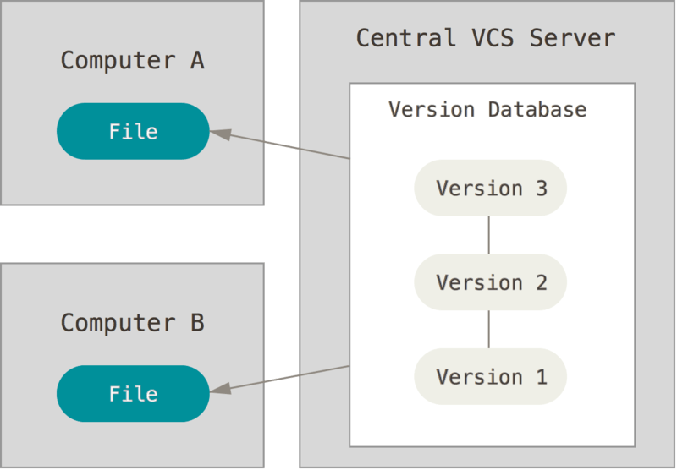
Centralized VCS

Slide 7
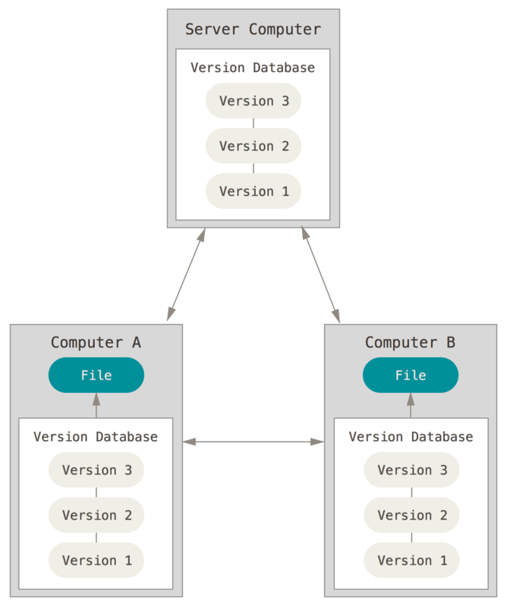
Distributed VCS

Slide 8
Semantic Versioning
Given a version number MAJOR.MINOR.PATCH, increment the:
MAJOR version when you make incompatible API changes,
MINOR version when you add functionality in a backwards compatible manner, and
PATCH version when you make backwards compatible bug fixes.
Additional labels for pre-release and build metadata are available as extensions to the MAJOR.MINOR.PATCH format.

Slide 9
Git Flow
The Gitflow Workflow defines a strict branching model designed around the project release. This provides a robust framework for managing larger projects.

Slide 10
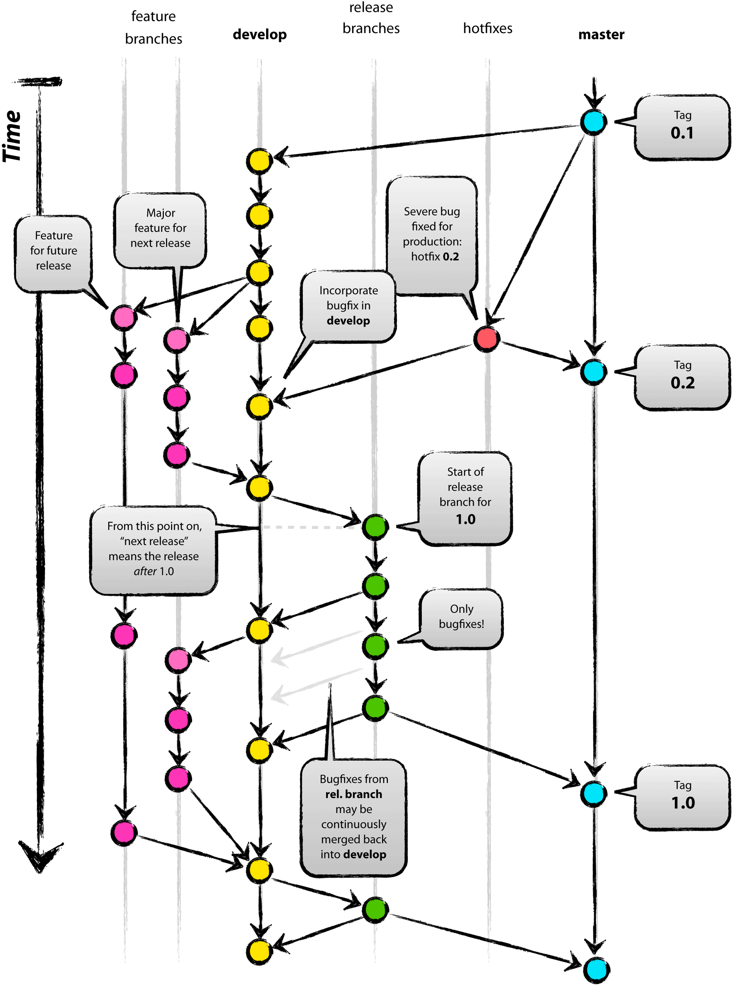
Git Flow Workflow

Slide 11
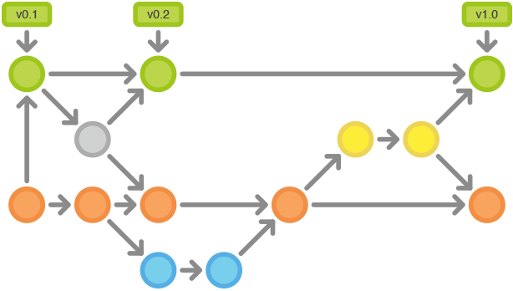
How Git Flow Works
Historical Branches
Feature Branches
Release Branches
Maintenance Branches

Slide 12
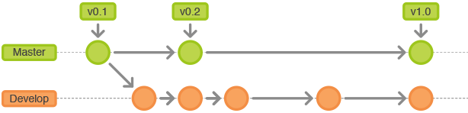
Historical Branches

Slide 13
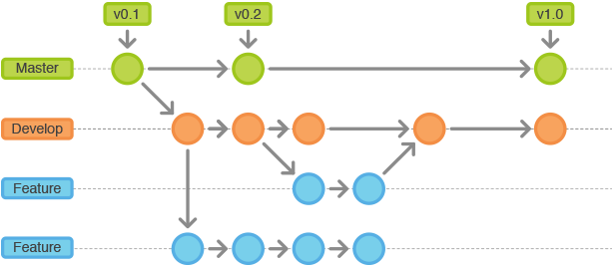
Feature Branches
Best Practices:
May branch off: develop
Must merge back into: develop
Branch naming convention: anything except master, develop, release-*, or hotfix-*

Slide 14
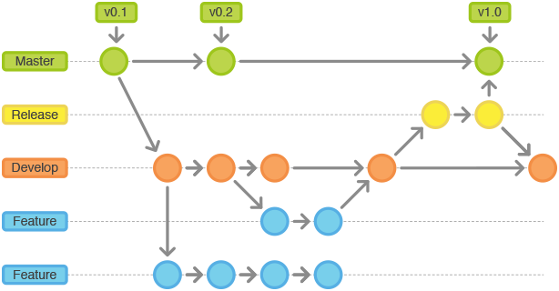
Release Branches
Best Practices:
May branch off: develop
Must merge back into: develop and master
Tag: increment major or minor number
Branch naming convention: release-* or release/*

Slide 15
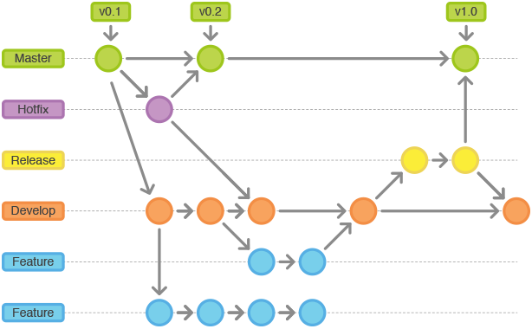
Maintenance Branches
Best Practices:
May branch off: master
Must merge back into: master and develop
Tag: increment patch number
Branch naming convention: hotfix-* or hotfix/*

Slide 16
References
https://www.atlassian.com/git/tutorials/comparing-workflows/gitflow-workflow
https://git-scm.com/book/en/v2/Getting-Started-About-Version-Control
https://jameschambers.co/writing/git-team-workflow-cheatsheet/
https://leanpub.com/git-flow/read
https://semver.org/

